Slide 1


Ad_Hoc Insights
Consumer Goods
CREATED BY
ROHITH KANDULA

Slide 2
WHY?
Objectives
WHAT?
Company’s detail and market
HOW?
Data, Requests, and Tools

Slide 3
WHY?
Objectives
Atliq Hardware, a fictional corporation, is a prominent computer hardware manufacturer in India and has a significant international presence. However, the management has acknowledged a lack of adequate information for making timely and informed decisions.
To address this issue, the company is planning to enhance its data analytics team by hiring junior data analysts. Tony Sharma, the Data Analytics Director, intends to assess potential candidates through a SQL challenge to evaluate their technical and interpersonal skills.
The company has identified the need for insights on 10 specific ad hoc requests, highlighting the importance of data-driven decision-making in their operations.

Slide 4
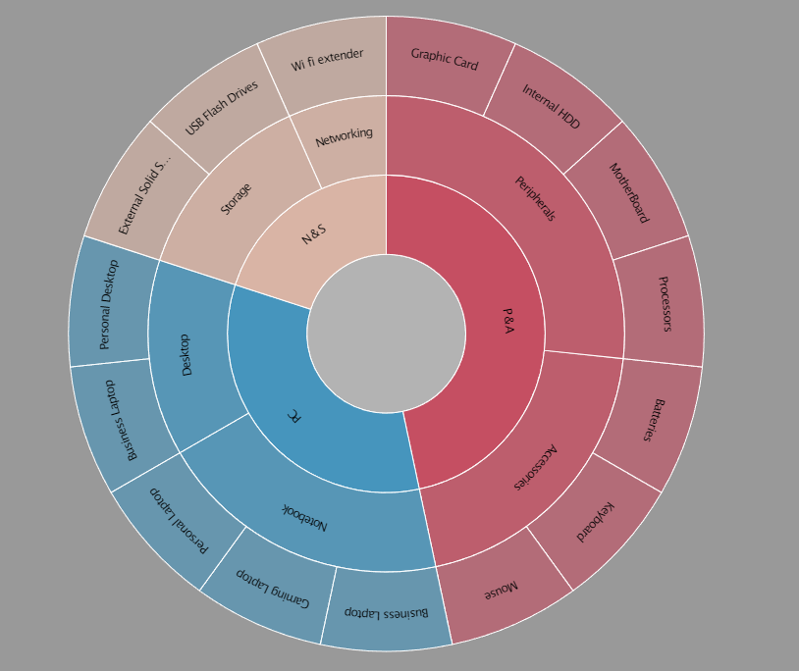
What?
Company Details
Outer Circle:
Category
FISCAL YEAR
SEP 2019 – AUG 2020
FY 2020
SEP 2020 – AUG 2021
FY 2021
Mid Circle:
Segment
Inner Circle:
Division
Atliq Hardware is a computer hardware and accessory manufacturer.

Slide 5
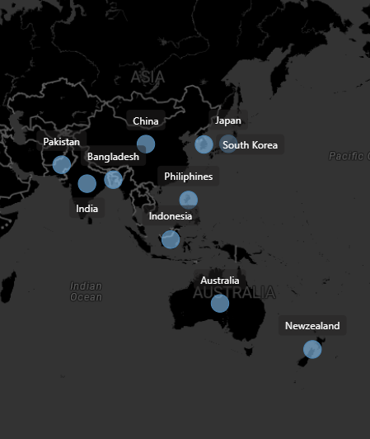
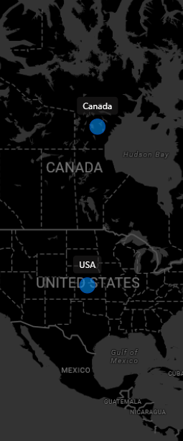
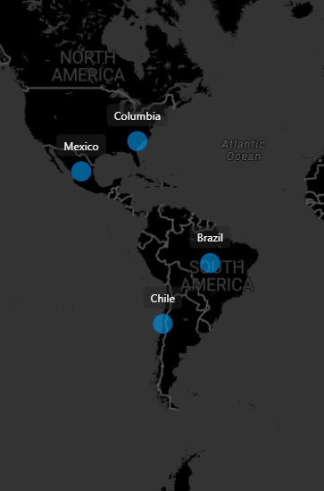
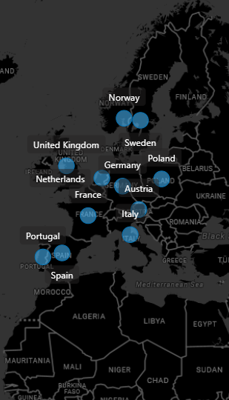
Company’s Market
NA
LATAM
EU
APAC
Atliq Hardware

Slide 6
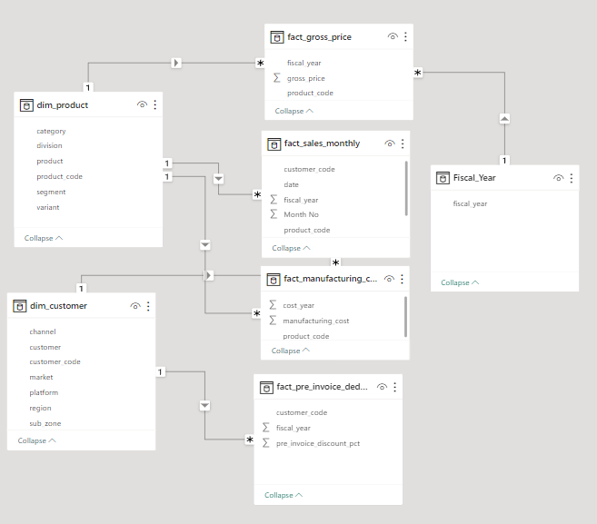
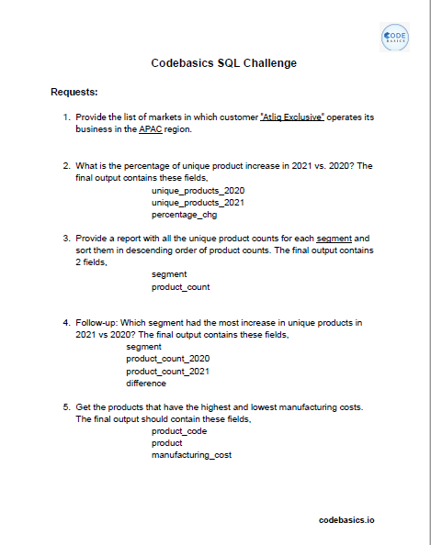
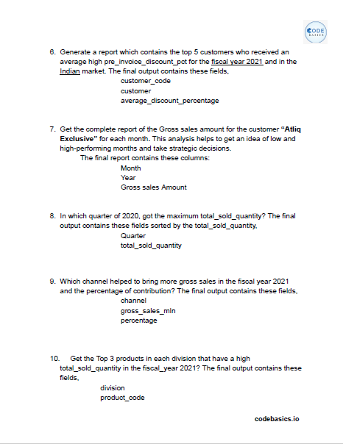


HOW?
DATA, Requests, and Tools
For Analysis and Visualization
Power BI

Slide 7

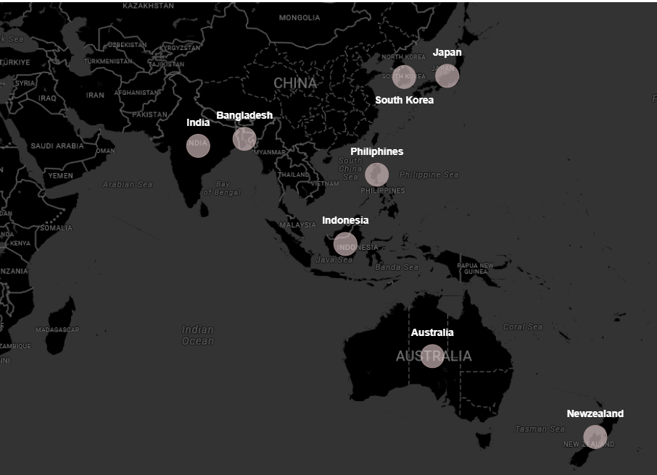
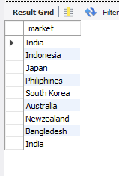
1. Provide the list of markets in which customer "Atliq Exclusive" operates its business in the APAC region.
Insight:
There are 8 Markets in which customer "Atliq Exclusive" operates its business in the APAC region.

Slide 8
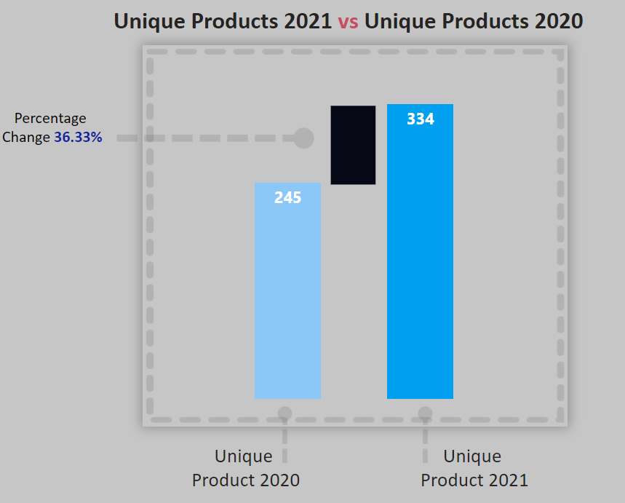

2. What is the percentage of unique product increase in 2021 vs. 2020? The final output contains these fields,
unique_products_2020
unique_products_2021
percentage_chg
Insight:
Production Increased by 36%.

Slide 9
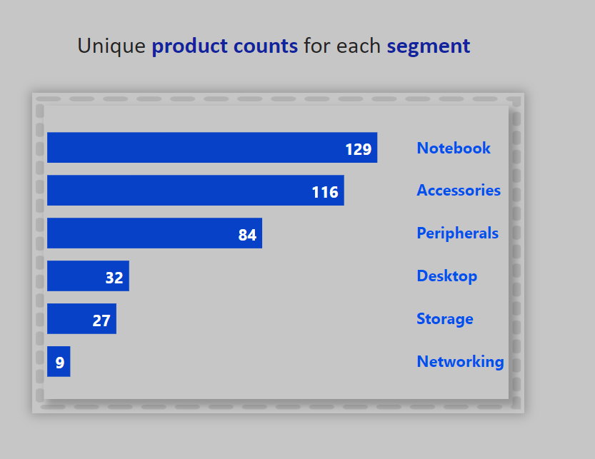
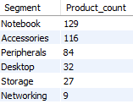
3. Provide a report with all the unique product counts for each segment and sort them in descending order of
product counts. The final output contains 2 fields,
segment
product_count
Insights:
Notebooks, accessories, and peripherals are experiencing substantial growth in manufacturing when compared to desktops, storage devices, and networking equipment.
Out of all the products being made, notebooks, accessories, and peripherals make up a whopping 83% of the total.

Slide 10
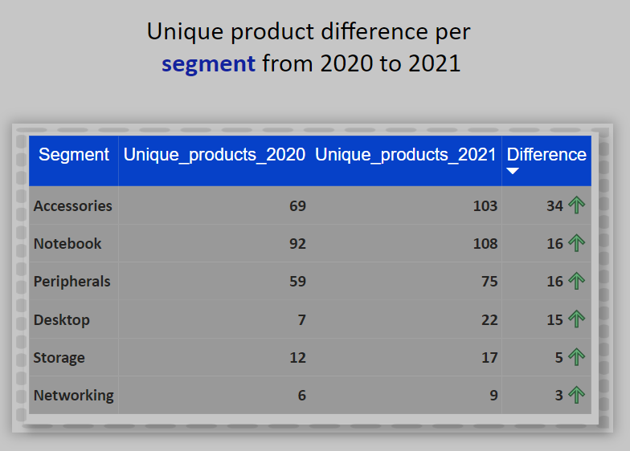
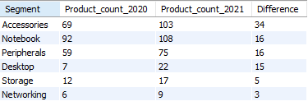
4. Follow-up: Which segment had the most increase in unique products in 2021 vs 2020? The final output contains these fields,
segment
product_count_2020
product_count_2021
difference
Insights:
Accessories having the largest , Notebook and Peripherals has the moderate increase in production.
Storage and Networking are experiencing the slower production growth compare to others.

Slide 11

5. Get the products that have the highest and lowest manufacturing costs. The final output should contain these fields,
product_code
product
manufacturing_cost
Insights:
Mouse: AQ Master wired x1 Ms has the Low manufacturing cost.
Personal Desktop: AQ Home Allin 1 Gen 2 has the High manufacturing cost.

Slide 12
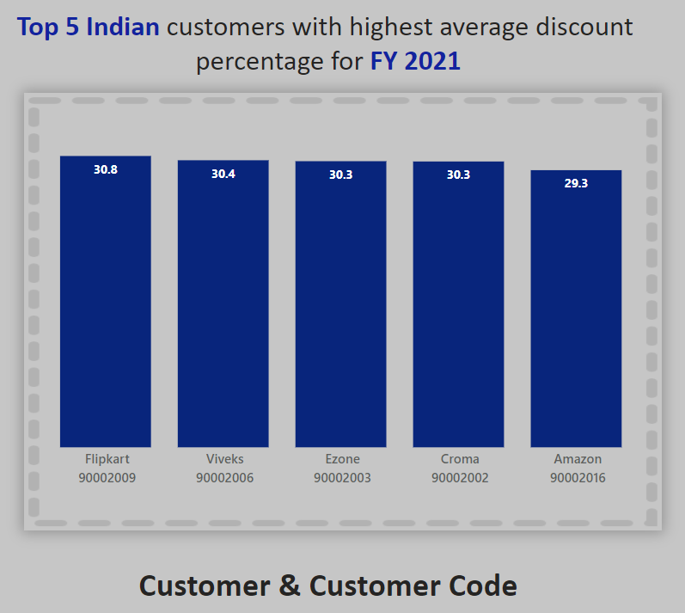
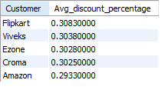
6. Generate a report which contains the top 5 customers who received an average high pre_invoice_discount_pct for the fiscal year 2021 and in the Indian market. The final output contains these fields,
customer_code
customer
average_discount_percentage
Insights:
Flipkart has given the Highest average pre-invoice discount.
Amazon has given the Lowest.

Slide 13
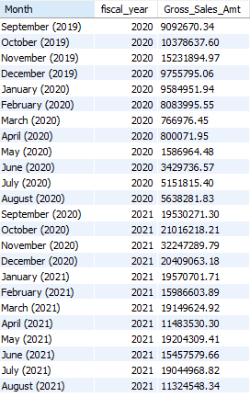
7. Get the complete report of the Gross sales amount for the customer “Atliq Exclusive” for each month. This analysis helps to get an idea of low and high-performing months and take strategic decisions. The final report contains these columns:
Month
Year
Gross sales Amount
FY 2020
Insights:
FY 2021
Overall Lowest Gross sales is recorded in March(2020).
The highest in the Overall Sales Recorded in November(2020).
73.8% of the total gross sales is in FY 2021.

Slide 14
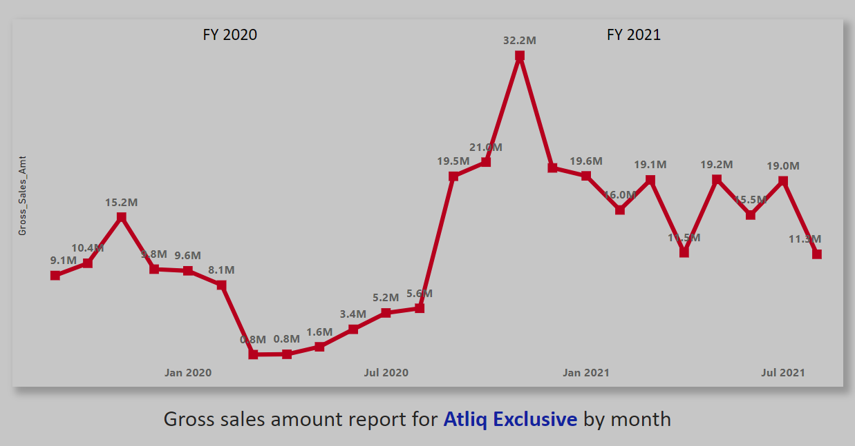
Reason:
Due to covid_19 there has been a very low Gross sales in the month of March and April in 2020.

Slide 15
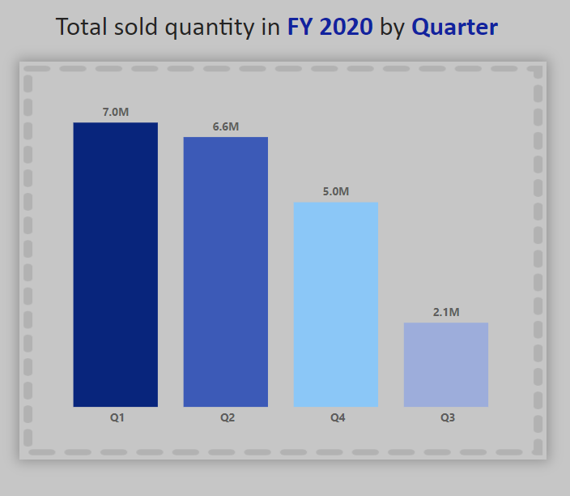
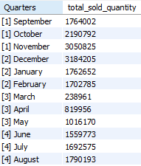
8. In which quarter of 2020, got the maximum total_sold_quantity? The final output contains these fields sorted by the total_sold_quantity,
Quarter
total_sold_quantity
Insights:
Qtr has recorded the highest sales and Q3 is the lowest .
December and march has recorded the highest and the lowest respectively By months.

Slide 16
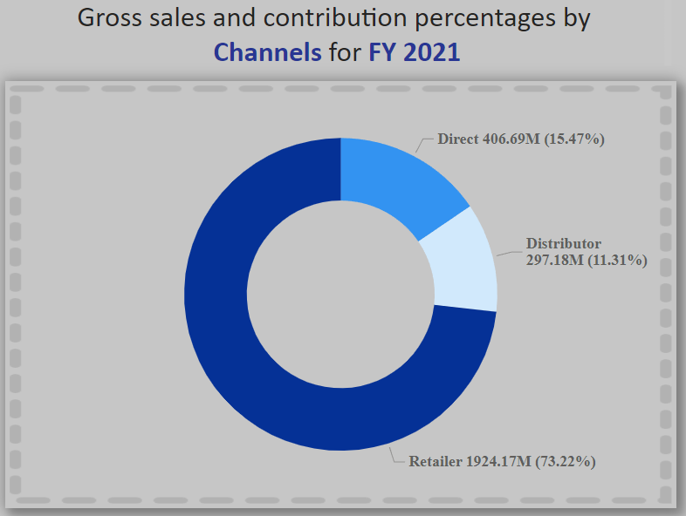

9. Which channel helped to bring more gross sales in the fiscal year 2021 and the percentage of contribution? The final output contains these fields,
channel
gross_sales_mln
percentage
Insights:
1. "Retailer" channel played a significant role by contributing 73.22% to the company's highest sales.
2. On the other hand, the "Distributor" channel had the lowest contribution percentage, accounting for just 11.31% of the total sales.

Slide 17
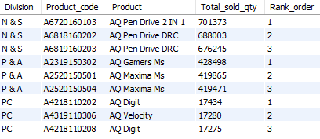
10. Get the Top 3 products in each division that have a high total_sold_quantity in the fiscal_year 2021? The final output contains these fields,
division
product_code
product
total_sold_quantity
rank_order
Insights:
In each division, there are unique product variants that appear twice within the top three products for that division.
Across all divisions, the top three products list includes distinct product variants that repeat.

Slide 18
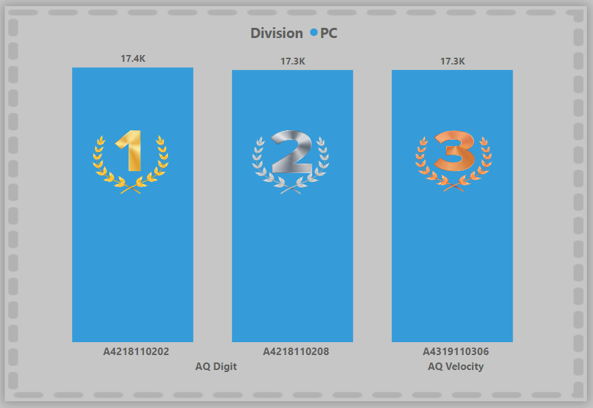
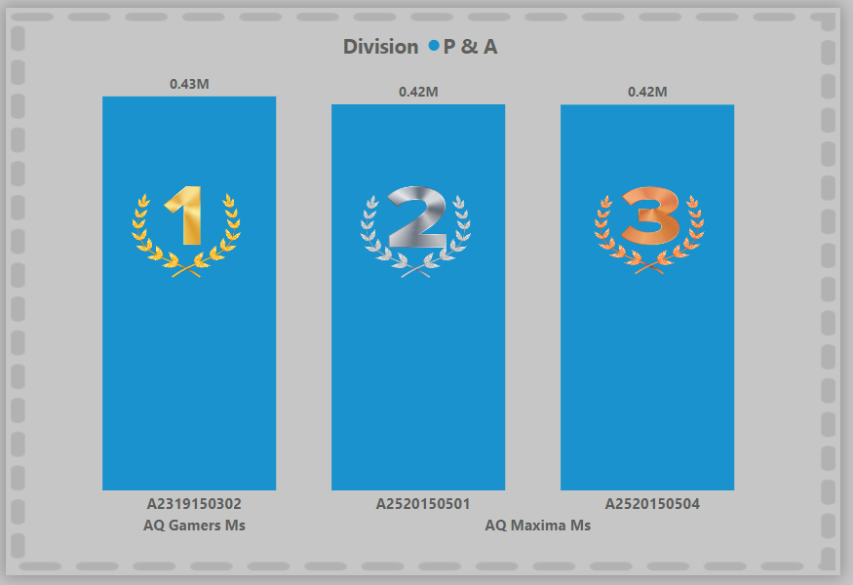
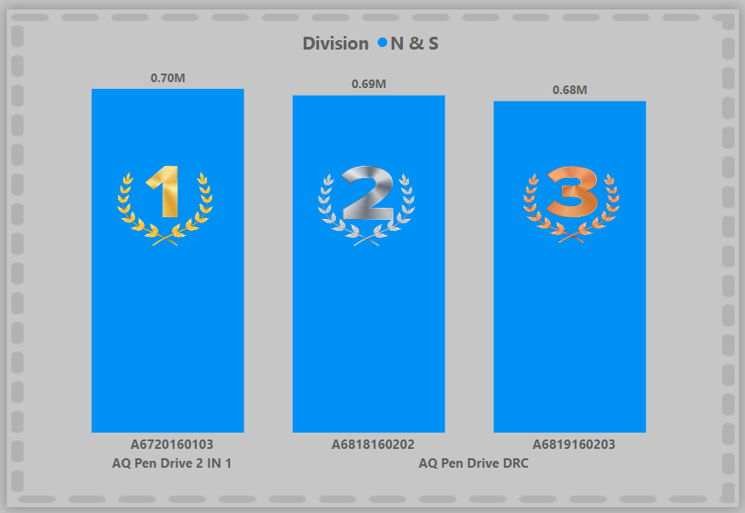
Top 3 highest-selling products by Division for FY 2021

Slide 19
Thank You….

